Slide 2
Culinary Arts
1 year program

Slide 3
First day of class:
Monday, August 21, 2023
EMCC @ Regions Restaurant
3000 N. Dysart Road, Avondale, AZ 85392
Monday - Thursday
1:00-3:45 PM
*Students are dropped if not present on first day of class

Slide 4
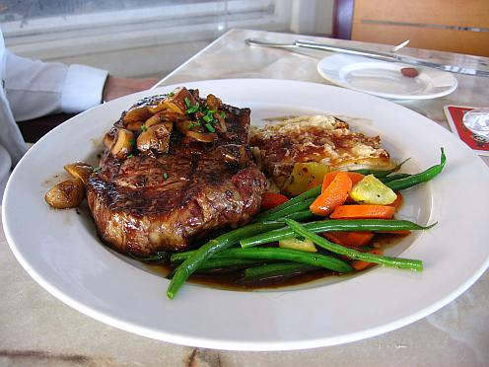
WHAT YOU LEARN IN THIS PROGRAM
How to utilize common culinary techniques in the effective production of savory foods and pastry products.
Apply national standards to the safe and sanitary handling of food and industrial kitchen equipment.
Practice comprehensive procedures for purchasing, inventory, and cost controls.
Practice professional and ethical behavior in the hospitality industry.
Demonstrate effective critical thinking and communication skills to facilitate teamwork, customer service, and time management.
Compose multiple flavors, textures, and colors into food and beverage products that are marketable to the appropriate food sector and reflective of industry trends.

Slide 5
COLLEGE CREDENTIAL
It’s important to note that students enrolled in the Culinary Arts Program are not only enrolled in a West-MEC program, but they are also college students enrolled in a Certificate of Completion Program at Estrella Mountain Community College.
Upon successful completion of the program, students can earn the following college credential that can be used for the job market:
Certificate of Completion-Culinary Arts I
To earn the Certificate of Completion-Culinary Arts I, students must achieve a grade of C or better in all of their Culinary college classes. This certificate also has several transfer options for students to continue their Culinary education.

Slide 6
Transfer within EMCC and University Options
Certificate in Culinary Arts I will transfer into the Culinary Arts II Certificate (EMCC)
Culinary Arts II will transfer into the A.A.S Degree in Culinary Arts (EMCC)
The A.A.S. Degree in Culinary Arts at EMCC will transfer at varying levels into the following Bachelor Degree programs:
Bachelor of Hotel and Restaurant Management, NAU
BIS-Hospitality Leadership, NAU
Bachelor of Applied Science, Foodservice Management, ASU
Bachelor of Hospitality Management, GCU

Slide 7
POST-SECONDARY PATHWAYS
Students earn 17 college credits
College credits transfer seamlessly into AA and Bachelor degrees
Information maintained on the West-MEC website.
Check out our 90-30 pathway with NAU!

Slide 8
ABOUT THE INSTRUCTORS –
JOE KALFUS
Education
M.A. Ed, Career Technical Education
Northern Arizona University
B.S. Hotel and Restaurant Management
Northern Arizona University
Biography
Chef Kalfus' experience in the hospitality field spans over 30 years. His industry experience includes work with Marriott Properties (Fairfield Inn and Camelback Inn), as well holding the positions of Kitchen Manager, Dining Room Manager, and General Manager at The Old Spaghetti Factory.
Chef Kalfus has over 20 years of Culinary and Hospitality instructional experience at both the high school and college level, teaching for Tolleson Union High School District, the Maricopa County Community College District System, and Le Cordon Bleu.
Before joining EMCC, Chef Kalfus was the Culinary, Commercial Baking, and Hospitality Program Director at the East Valley Institute of Technology in Mesa, Arizona. There, he also coached the FCCLA Culinary competition team.

Slide 9
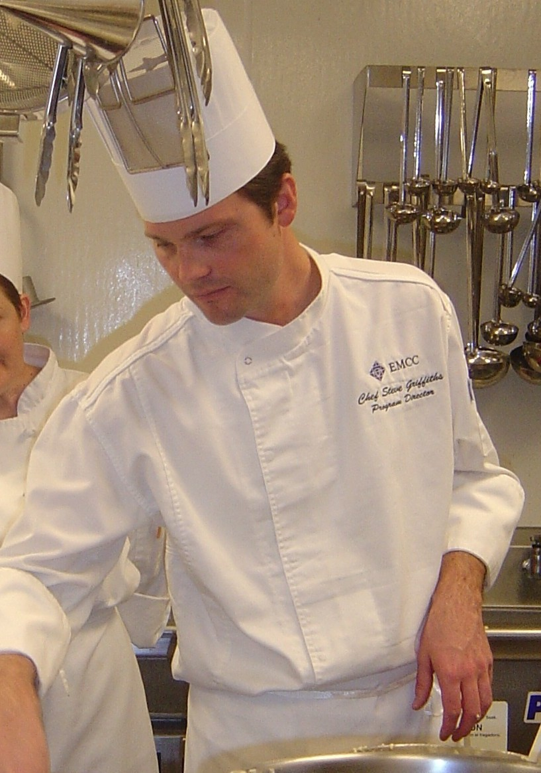
ABOUT THE INSTRUCTORS - STEVE GRIFFITHS
Education
M.Ed in Educational Leadership
Northern Arizona University
Bachelor of Applied Science
Arizona State University
AAS Culinary Arts
White Mountains Community College
Biography
Chef Griffiths gained his culinary experience from the kitchens of the Balsams Grand Resort Hotel, Pinehurst Resort and Country Club, The Crowne Plaza Hotel (Nashua), and Legal Sea Foods of Boston. In addition to holding Executive Chef, Chef Garde Manger, and Banquet Chef positions, he brings many years of teaching experience to the students of EMCC. As an instructor he has coached student teams for the ACF Junior Hot Food Competition, as well as the winning team at the National Collegiate Ice Carving Championships. Further culinary training was completed at the Notter School of Pastry Arts, The French Pastry School, and the Institute of Culinary Education-NYC. He has won several awards for ice sculpture, including fourth place in the single block competition at the 2004 World Ice Art Championships in Fairbanks, Alaska.

Slide 10
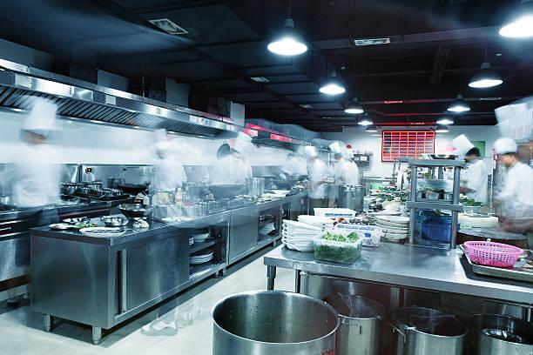
SCHEDULE
First day of class at the EMCC Campus:
Monday, August 21nd
1:00 – 3:45 PM
Students will receive an orientation on how to use their Canvas and student email accounts during the first week of classes.
Please come to class in uniform with your ServSafe textbook.
*Students are dropped from the program if not present on first day of class, unless an absence was otherwise communicated to the instructor and West-MEC offices.

Slide 11
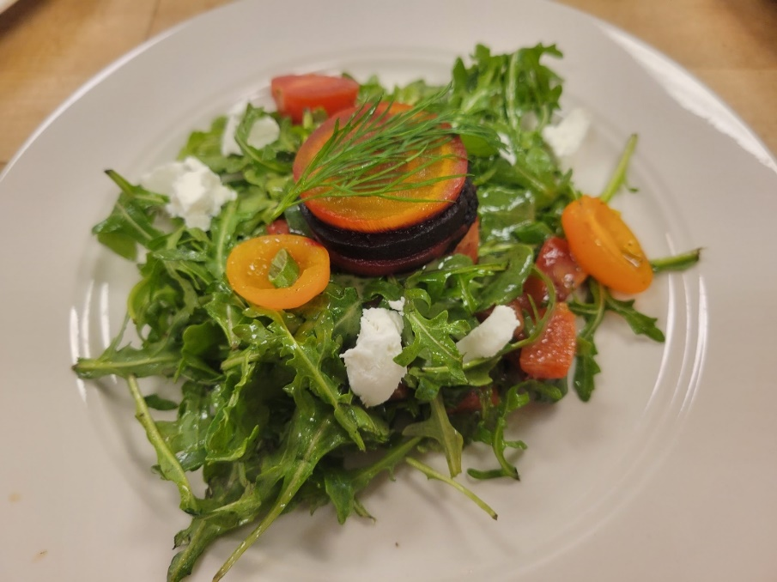
Courses by Semester
EMCC schedule vs. High School Schedule
Monday-Thursday: 1pm-3:45pm
Fall ‘23
CUL113 Commercial Baking (August-October / 8 weeks)
CUL115 Sanitation (August-December / 16 weeks)
CUL105 Principles of Professional Cooking (October-December / 8 weeks)
Must earn 70% in ALL 1st sem. courses; pre-requisite for 2nd Sem.
Spring ‘24
CUL103 Breakfast and Cold Foods (January-March / 8 weeks)
CUL120 Food Costing (January-May /16 weeks)
CUL201 International Cuisine (March-May / 8 weeks)
Students enrolled in the Culinary Arts program must attend class during the dates required. EMCC schedule does not match high school schedules (Fall and Spring Break).

Slide 12
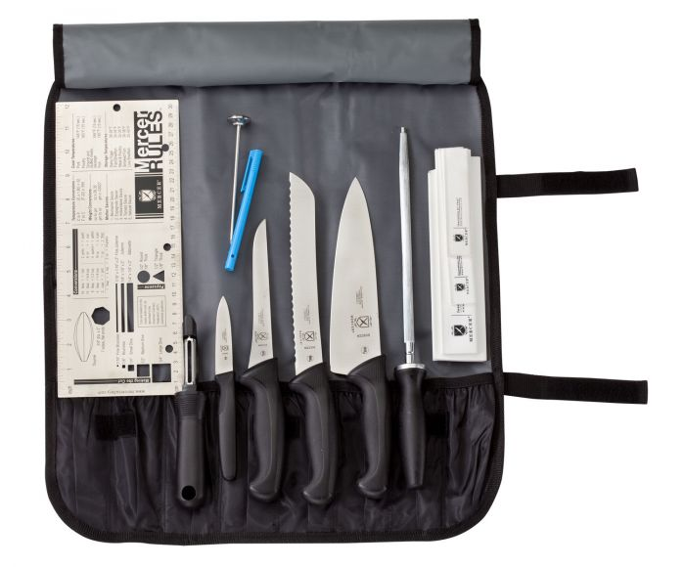
WHERE TO MEET ON THE EMCC CAMPUS
Culinary Students will meet in Regions Restaurant, located in Agave Hall at the EMCC Campus.
Please see location and map on next page. Regions is located on the South side of the Campus, in Agave Hall.
Parking is recommended in Lot CW, off of the Dysart Road entrance to the college.
Please make an effort to visit the college campus before classes begin so that students feel comfortable in knowing where to go on the first day of class.

Slide 13
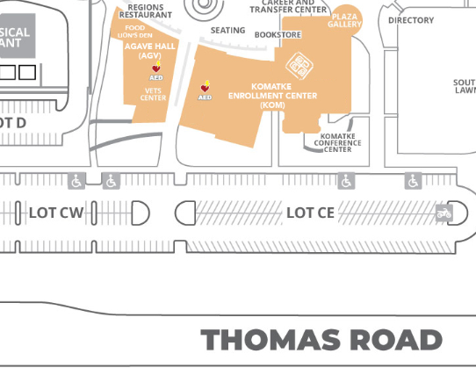

Slide 14
TUITION - PLEASE NOTE
West-MEC pays the EMCC college tuition for in-state students, but the tuition amount will remain on the individual student’s account until fiscal processes are complete between West-MEC and EMCC offices.
A tuition bill may appear on the student’s EMCC account and student center, along with email notification from the college for tuition due.
PLEASE IGNORE THESE MESSAGES AND BALANCE IF THEY APPEAR IN THE STUDENT ACCOUNT AT ANYTIME DURING THE FALL AND SPRING SEMESTER.
All student accounts for the West-MEC Culinary cohort are coded as third party billing, and the student/parent is not responsible for the tuition.

Slide 15
ATTENDANCE
Attendance is a valued employability skill.
For this reason, both excused and unexcused absences count towards student attendance totals as outlined in college policy.
See Syllabus for CUL113

Slide 16
ABSENCE REPORTING
If a student is not present during class, they will receive zero participation points, unless the absence falls under official absence guidelines or observation of religious holidays.
Attendance is taken at every face to face (F2F) class meeting. Students are expected to attend class on time for each scheduled F2F class session.
Each student is responsible for obtaining information and assignments given during a missed F2F class meeting.
If a student will be absent from a F2F class session, they must report the absence to the instructor and West-MEC offices.
Report Absences to both EMCC and West-MEC using the information below:
EMCC:
Please email instructor before class begins using your Canvas email account.
AND
West-MEC:
Call West-MEC within 24 hours of absence
(623) 738 1058

Slide 17
ATTENDANCE
Excused Absences
Timely notification from parent/guardian (verbal or written)
(e.g. Doctor appointment, school performance, graduation)
Extended absence due to medical condition documentation
Unexcused Absences
No notification to West-MEC
Tardies and early departures may also impact attendance.

Slide 18
CALENDAR
West-MEC calendar differs from high school calendar.
Please follow West-MEC calendar for Culinary schedule.

Slide 19
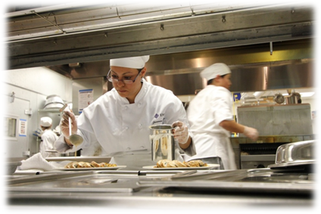
DRESS CODE
Which one of these chefs would you trust to cook your food?
EMCC Culinary Arts requires uniforms, good personal hygiene, and professional behavior during class meeting times.

Slide 20
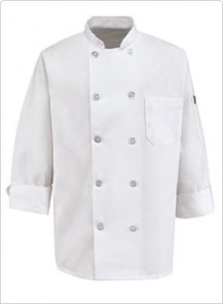
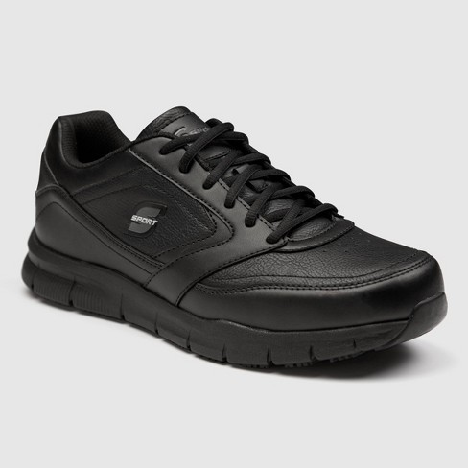
MANDATORY DRESS CODE FOR LAB BASED COURSES
For Culinary Lab Courses, students must follow the uniform guidelines below. Students are not allowed to wear uniforms from an outside business or other organization.
Purchase from EMCC Bookstore:
2 ea Chef Jackets-clean and wrinkle free for class
2 ea Check Pants
2 ea Beanie Hat-hair above shoulders and restrained under hat
2 ea Aprons-clean and wrinkle free for class
Students Purchase on their Own:
White T-Shirts-to be worn under chef jacket
Black shoes, Smooth Surface / Easy Clean, Non-slip, closed toe
Socks that fit above the ankle (for protection from hot liquid spills)

Slide 21
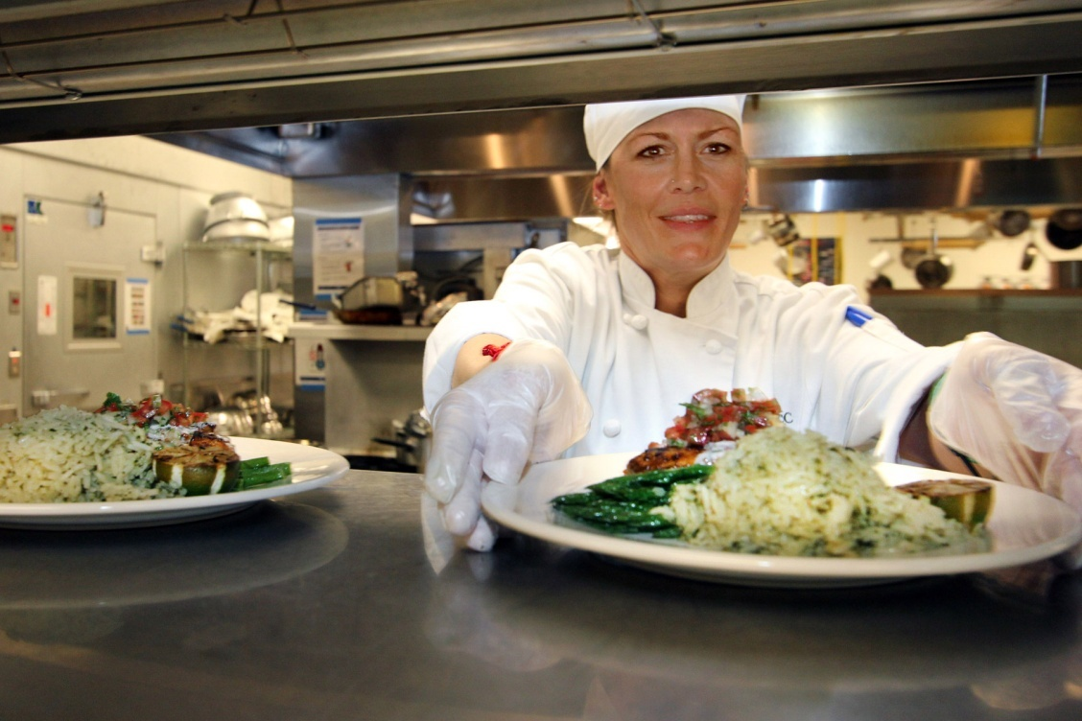
Department Policies
Syllabus Review
Technology
Uniforms
Hygiene

Slide 22
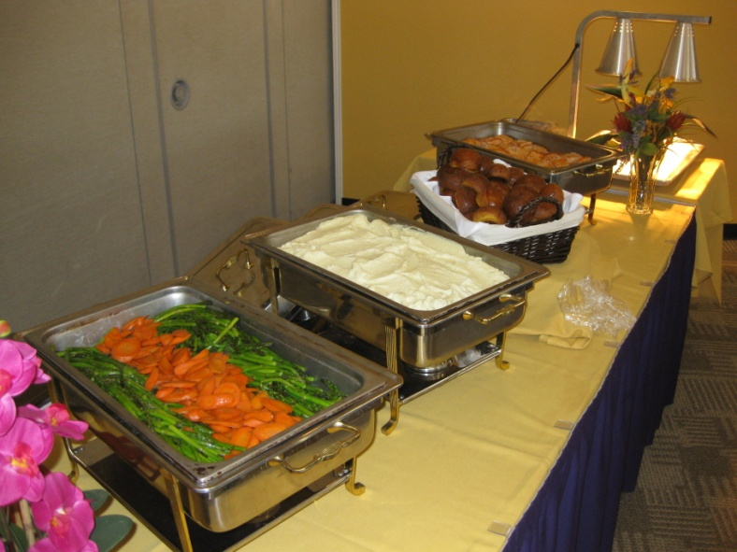
WHAT TO EXPECT
Knives and other tools will be provided by the college
Follow Professional Uniform Standards
Punctuality-You are graded on being on time.
Fast Pace-on your feet for extended periods of time
Cleaning: The kitchen receives a thorough cleaning by students at the end of each lab period.
Try everything at least once.
Constructive, yet honest criticism

Slide 23
WHAT TO EXPECT
Safety is taken very seriously.
Please report any and all injuries to instructor immediately.
If medical attention is required, campus Safety and Security will be contacted to determine next steps.

Slide 24
GRADES
GRADING SCALE
A | 90%-100%
B | 80%-89%
C* | 70%-79%
D** | 60%-69%
*A 70% grade or better is required for each EMCC Culinary course in order to obtain college credit.
**A 60% grade or better is required to obtain high school credit.
Credits issued by West-MEC | 2.5 High School Elective Credit
Credits issued from EMCC | 17 Community College Credits
College course competencies meet prerequisites as students move through the program.
Students will be dropped, if they are failing courses.

Slide 25
GRADES
Fall:
College Transcript:
Students earn letter grades/credits in each college course
High School Transcript:
Students earn one (1) letter grade/one (1.25) credits reflecting the average of the three (3) college course grades.
Spring:
College Transcript:
Students earn letter grades/credits in each college course
High School Transcript:
Students earn one (1) letter grade and one (1.25) credits reflecting the average of three (3) college course grades.

Slide 26
WITHDRAWALS
Withdrawals from a course will be reflected as follows:
High School transcript grade will show as “W” for withdrawn
College transcript will show as letter grade based on student performance at the time of the withdrawal.

Slide 27
FERPA
Family Educational Rights and Privacy Act
West-MEC Culinary students are also college students.
Because they are college students, confidentiality is protected by FERPA.
Faculty are unable to discuss grade status with parents if issues arise, unless the student signs a FERPA waiver.
To complete a FERPA waiver, please work with admissions / registration personnel.

Slide 28
DISABILITY SERVICES
Students with an IEP or a 504 Accommodation Plan and/or health conditions are expected to self-advocate
Services offered at High Schools do not automatically carry over to the college program.
Students / Parent must initiate assistance with the
EMCC Community College Disability Coordinator
for intake and potential accommodations.
For more information, please call EMCC at:
(623) 935-8863

Slide 29
CONDUCT
The Culinary Arts Program is not an after school cooking club. Content in the program follows the same rigor and grading standards as the adult Culinary Arts Program at EMCC (assignments, practical / written exams, projects, etc.), and students will experience a serious approach to cooking, sanitation, and fiscal operations. We ask for both student and parent/guardian buy-in over the next year so that this program provides a successful experience for all involved.
High expectations for professional conduct
Maturity level on par with industry
Cell phone usage based on campus policy
Behavioral Concerns will be communicated to students/parents through EMCC and West-MEC
College discipline guidelines apply if student fails to comply with the rules and regulations

Slide 30
CTSO
Culinary students are encouraged to participate/compete in FCCLA at their home High School.
Contact your school’s FCCLA advisor and consider competing in a Culinary event.

Slide 31
EMT Students are encouraged to apply for NTHS.
3.0 min. GPA at High School
B or Higher in EMT
CTSO, Volunteer, or Leader of Organization
Outstanding Conduct
Applications and documentation: March, Induction Ceremony
Stoles are worn at Recognition Ceremony

Slide 32
BULLYING
It is the right of every student to be educated in a positive, safe, caring and respectful learning environment.
A school environment inclusive of these traits maximizes student achievement, fosters student personal growth, and helps students build a sense of community that promotes positive participation.
Bullying, harassment or intimidation will NOT be
tolerated at West-MEC or EMCC.

Slide 33
FEES
West-MEC Registration Fee - $125.00 VS. $1,989 MCCD Tuition
MCCD charges West-MEC tuition after students attend Day 1
NO Registration Fee refunds after Day 1 of school.
Reminder- disregard any emails from college re tuition

Slide 34
CERTIFICATION
Maricopa County Food Service Worker Certification- Reminder-Must be obtained before start of class
During the program, students will have the opportunity to test for the ServSafe Food Protection Manager Certification, which is nationally recognized, and is a level above the
Food Service Worker Certification.

Slide 35
WEST-MEC
Transportation Grant
College Textbook Grant Applications may be found on the West-MEC website
https://www.west-mec.edu/Page/154
If you have questions, you may contact
West-MEC Student Services
speranta.klees@west-mec.org
623-738-0018

Slide 36
Communication
When notified by Chef, West-MEC staff will communicate concerns regarding grades, attendance or behavior to parents, high school counselor or administrator.
Students and parents, please set up phone to accept calls & voice mail and check messages daily. Call back promptly. Check email and respond professionally.
A limited number of city bus passes are available to students based on financial need.
Applications may be found on the West-MEC website
If you have questions, you may contact
West-MEC Student Services
speranta.klees@west-mec.org
623-738-0018

